Slide 1

All India Women Hackathon
<AI4GOOD>

Slide 2
Executive Summary
Initiative Goal: <AI platform which will help to reduce food waste and donate food to needy people>
We recommend: <To reduce over demanding or overproduction in food industry to avoid food wastage and help to control global warming>
<This will help to reduce water wastage as water is source for production of food>
<Donate the food which is in excess amount and to donate it to needy with help of NGO>
We proposes that the steps are:
1. Restaurant Registration
2.NGO Registration Form
3.AI Models:Matcher Module: Matches restaurants with relevant NGOs based on their profiles.
Route Optimization Module: Calculates optimal routes for food distribution.
Recommendation Module: Suggests whether food should be recycled/denoted
4.Admin panel

Slide 3
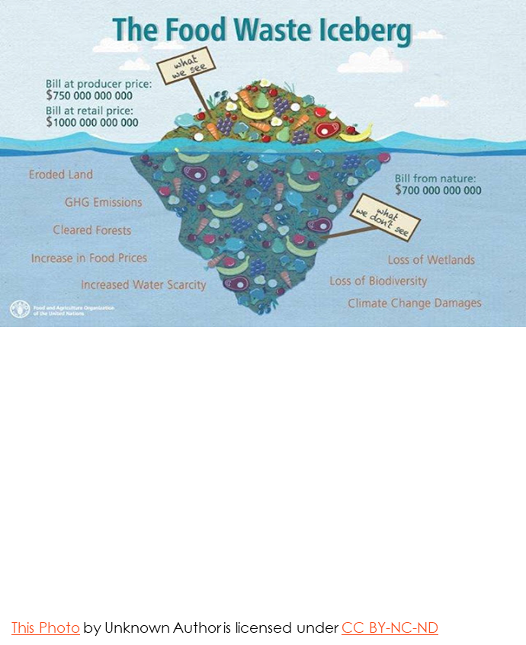
Outcome and Methodology
1.AI Powered Matching Algorithm
In this , it will provide connection between restaurants and NGO , Food packaging industry with NGO to donate extra food
2.Food Waste Collection
In this we will provide form for restaurant ,food industry to provide information about food like quality ,quantity,photo,expiry date, name of company
3.Recycle available food
With the help of AI , our model will provide different food recipes from available food or raw material
4. Set alarm for alert of expiry date
AI will provide notification for expiry date of food available to either donate or recycle it before expiry

Slide 4
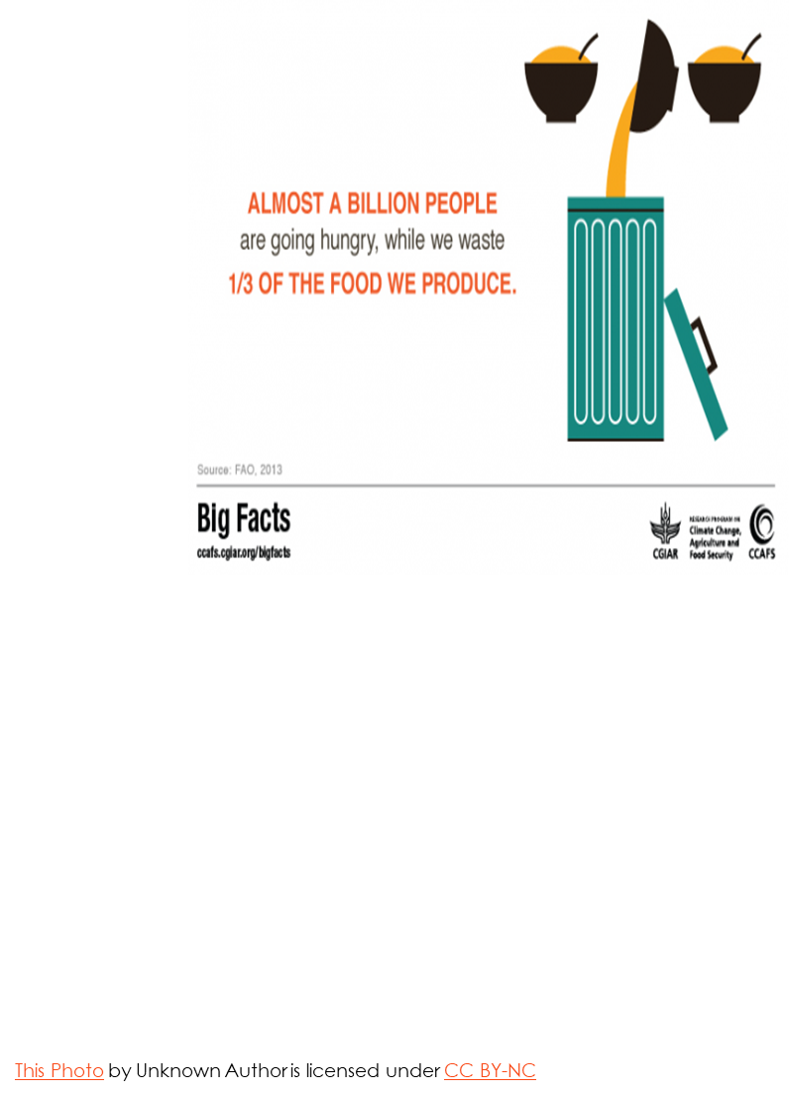
Outcome and Methodology
5.AI shortest Path :
It will provide shortest path option if time is late and food delivery is not available then with this AI shortest path people can share food to nearest NGO so that food can be donated before it get spoiled

Slide 5
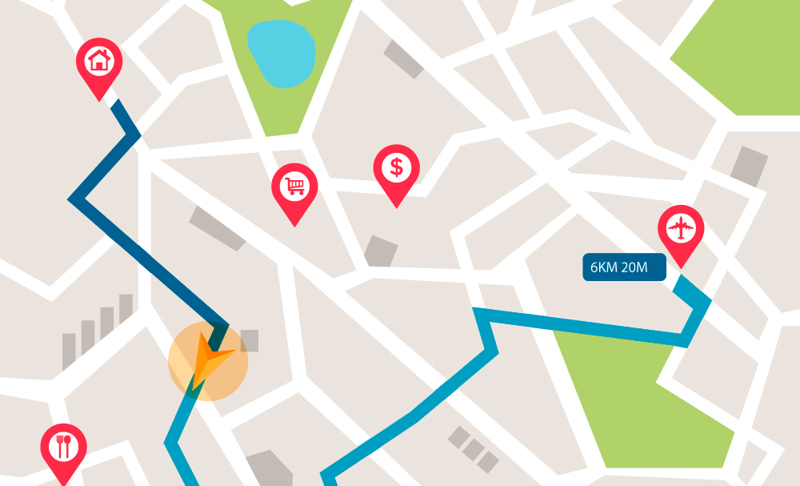
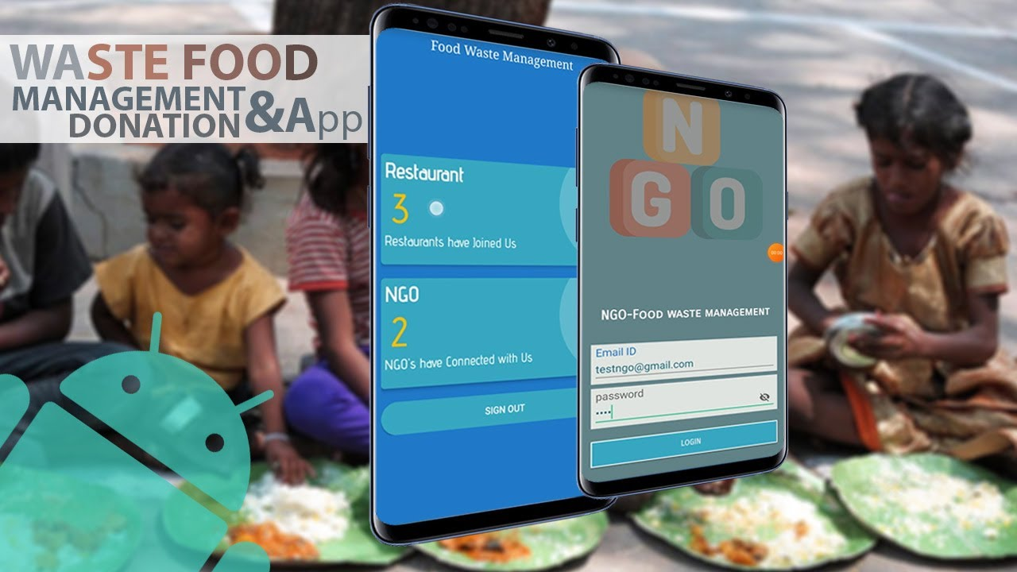
Proving this works
1. Matcher Module Validation
Objective: Validate the model's ability to accurately match restaurants with relevant NGOs based on their profiles.
2. Route Optimization Module Validation
Objective: Validate the model's ability to calculate the most efficient routes for food distribution.
3. Recommendation Module Validation
Objective: Validate the model's ability to recommend whether food should be recycled or donated.

Slide 6
Steps for Validation
Dataset Preparation:
Collect a dataset of restaurant and NGO profiles, including features like location, type of food, capacity, and operational hours.
Split Data:
Split the dataset into training (70%), validation (15%), and test (15%) sets.
Training and Validation:
Train the model on the training set.
Validate the model on the validation set to tune hyperparameters and prevent overfitting.

Slide 7
Steps for Validation:
Performance Metrics:
Precision and Recall: Evaluate how well the model is matching relevant NGOs to restaurants.
F1-Score: Calculate the harmonic mean of precision and recall.
Confusion Matrix: Analyze true positives, false positives, true negatives, and false negatives.
Cross-Validation:
Perform k-fold cross-validation (typically k=5 or 10) to ensure the model's robustness.
Human Evaluation:
Have human experts review a subset of matches to provide qualitative feedback.

Slide 8
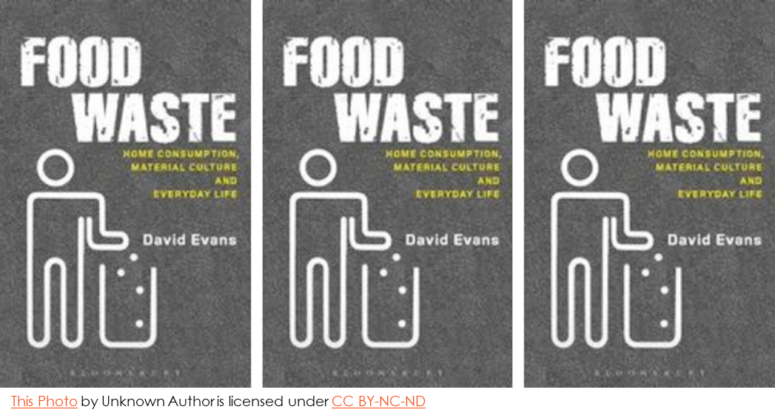
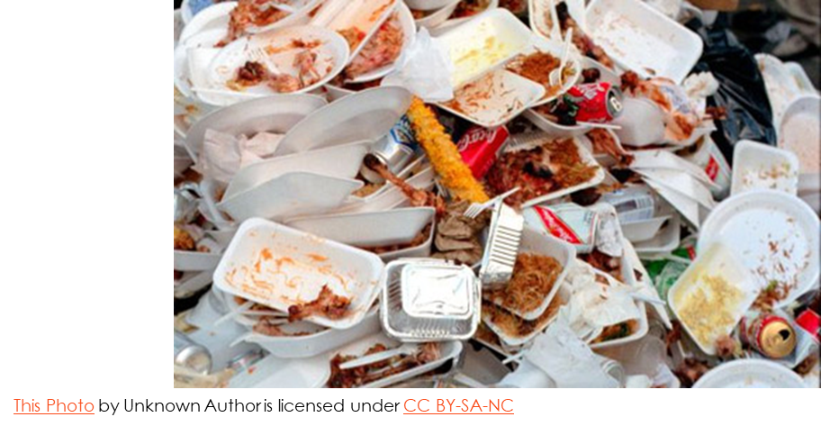
Business Value
What is the overall value of this solution?
•Reduction of Food Waste
•Support for NGOs and Communities
•Informed Decision-Making

Slide 9
Visualize current state and ideal:
Aspect | Current state | Ideal State
Food Wastage | High | Low
Environmental Impact | Significant | Reduced
NGO Food Supply | Unreliable | Consistent
Logistic Efficiency | Low | High
Transportation Costs | High | Low
Coordination | Limited | Seamless
Community Impact | Minimal | Significant

Slide 10
Deployment Plan and Integration
1)How do you make sure this is easy to use?
1.Simple Forms Prepare for Deployment
2.Clear Instructions
3.Intuitive Design
4. Automatic Matching
5.Mobile-Friendly
6. Admin Control
2)How and where will you push this solution to production?
Below is the flow diagram given in which we have shown how these solution is push into a production
Select Hosting Platform
Set Up CI/CD Pipeline
Deploy Applica-tion
Ensure Securit-y
Launch and Post-Deployment
Monitor & Feedback
Update & Maintain

Slide 11
Deployment Plan and Integration
3)What platform/tool could you use, how would an end user interface with the solution? How can it be ensured that the solution stays accurate
Development Platforms/Tools:
Frontend:
Html,css,Javascript
Bootstrap or Material-UI for responsive design.
Backend:
Node.js, Express.js
RESTful APIs or GraphQL for communication between frontend and backend.
Database:
MongoDB for NoSQL databases.
Version Control:
Git with GitHub or GitLab for source code management.

Slide 12
Deployment Plan and Integration
2. End User Interface
Responsive Design
User-Friendly Navigation
Food Waste Tracking
Donation Options
Educational Content
Community Forum
Interactive Maps
Notifications and Alerts
Analytics Dashboard

Slide 13
Deployment Plan and Integration
3. Ensuring Accuracy
Data Validation:
Implement strict data validation rules on both frontend and backend.
Regular Updates:
Schedule regular updates and maintenance.
Automated Testing:
Use unit tests, integration tests, and end-to-end tests.
Monitoring:
Continuous monitoring with tools like Prometheus and Grafana.
User Feedback:
Implement a feedback mechanism for users to report issues.
Backup and Recovery:
Regular backups and a robust recovery plan to prevent data loss.

Slide 14
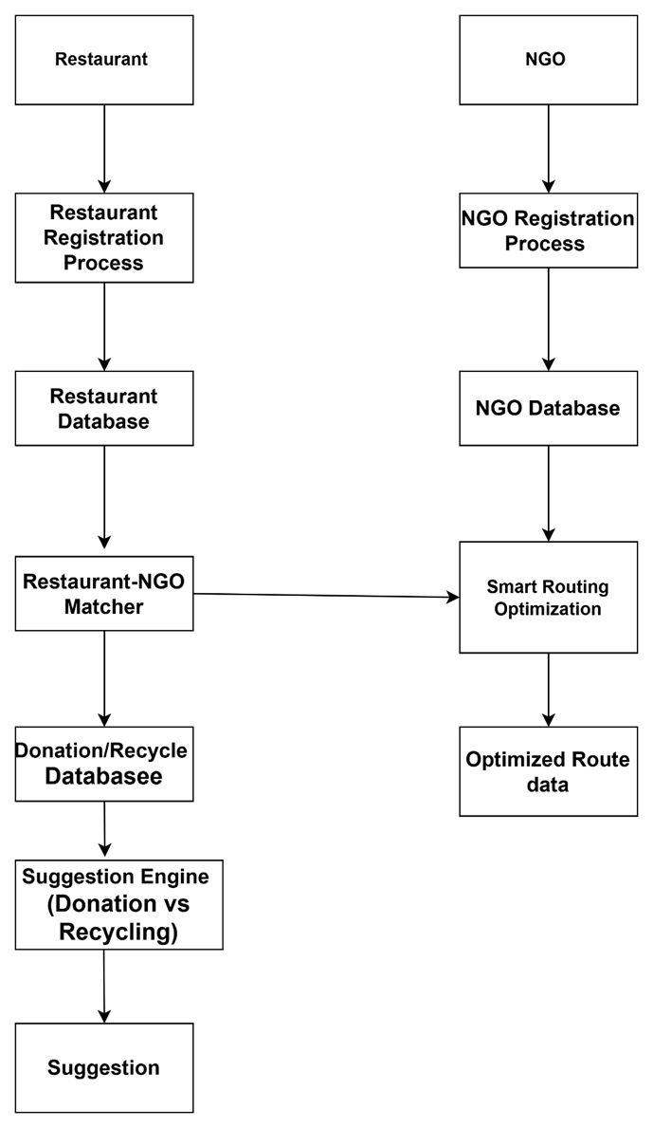
DataFlow Diagram

Slide 15
Recommendations and Next Steps
Potential plans for the future. How can one build on top of this solution?
Expansion to New Geographical Areas:
Scale the platform to cover more cities, states, and eventually, countries.
Tailor the solution to different regions' specific needs and regulations.
Mobile App Development:
Develop a mobile app for restaurants and NGOs to register, view matches, and manage donations on the go.
Include real-time notifications and updates for both donors and recipients.
Enhanced AI Capabilities:
Improve the Matcher Module with more sophisticated algorithms and additional data sources to increase matching accuracy.
Enhance the Route Optimization Module with real-time traffic data and dynamic routing capabilities.
Refine the Recommendation Module with continuous learning and feedback loops to improve decision-making over time.

Slide 16
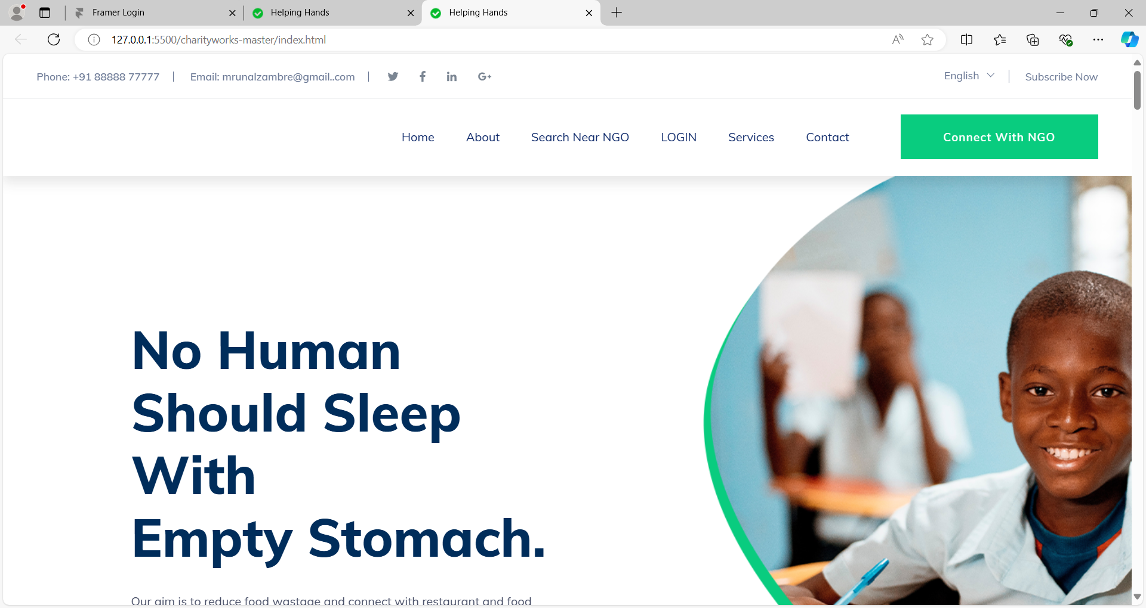
Output window

Slide 17


